Slide 1
Method Overloading & Overriding
Overloading: multiple methods of the same name and return type in the same class
Constructors can be similarly overloaded
Overloaded functions: different functions, distinguished by argument types
These are two different functions:
stack::stack(int n);
stack::stack();
Overriding
- Use virtual and override
- Only method declared with virtual can be overridden
– E.g. In Car (parent): public virtual void Accelerate ()
In Volvo (child): public override void Accelerate ()

Slide 2
Method Overloading & Overriding
Overriding (cont')
- If no virtual and override is used, will simply be method hiding, not method overriding
– Although a virtual method can be overridden, it doesn't have to be.

Slide 3
Overriding
A method in child class overrides a method in parent class if they have the same name and type signature.
Overriding
classes in which methods are defined must be in a parent-child relationship.
Type signatures must match.
Dynamic binding of messages.
Runtime mechanism based on the dynamic type of the receiver.

Slide 4
Overloading - single method name having several alternative implementations.
Overriding - child class provides alternative implementation for parent class method.
Polymorphic variable – a variable that is declared as one type but holds a value of a different type.

Slide 5
Overloading
Overloading Based on Type Signatures
Same method name with different implementations having different type signatures.
Occurs in object-oriented languages (C++, Java, C#, Delphi Pascal)
Class Example {
Add (int a) { return a; }
Add (int a, int b) { return a + b; }
Add (int a, int b, int c) { return a + b + c; } }
C++ allows methods as well as operators to be overloaded.

Slide 6
Overriding Notation
C++
class Parent {
public:
virtual int test (int a) { ... }
}
class Child : public Parent {
public:
int test (int a) { ... }
}
C#
class Parent {
public virtual int test (int a) { ... }
}
class Child : Parent {
public override int test (int a) { ... }
{

Slide 7
Overriding Vs. Method hiding
Overriding
public class Car {
public virtual Accelerate (...) {...}
}
public class Volvo:Car {
public override Accelerate (...) {...}
}
public static void Main() {
Volvo v = new Volvo ();
v.Accelerate(); -Which of the methods is called? Car c = (Car) Volvo;
c.Accelerate(); -Which of the methods is called? }

Slide 8
Overriding Vs. Method hiding
Method hiding
public class Car {
public void Accelerate (...) {...}
}
public class Volvo:Car {
public new Accelerate (...) {...}
}
public static void Main() {
Volvo v = new Volvo ();
v.Accelerate(); -Which of the methods is called?
Car c = (Car) Volvo;
c.Accelerate(); -Which of the methods is called?
{

Slide 9
Virtual Methods and Overriding (polymorphism and dynamic binding)
class Base
{
public virtual void who()
{
Console.WriteLine("who() in Base");
}
}
class Derived 1 :Base
{
public override void who()
{
Console.WriteLine("who() in Derived1");
}
}

Slide 10
class Derived2:Base
{
public override void who()
{
Console.WriteLine("who() in Derived2");
}
class Derived 3 :Base
{
//does not override who()
}

Slide 11
class Main_class
{
[STAThread]
static void Main(string[ ] args)
{ Base[] baseRef=new Base[4];
Base baseObj=new Base( );
Derivedl dl=new Derived1( );
Derived2 d2=new Derived2( );
Derived3 d3=new Derived3( );
baseRef [0]=baseObj;
baseref [1]=d1;
baseRef [2]=d2;
baseref [3]=d3;
For(int i=0;i<4;i++)
{
baseRef[i].who( );
}

Slide 12
Abstract Method
An abstract method is one that does not include a definition (it only defines a
protocol). This is pure virtual in C++.
An abstract class is one that includes at least one abstract method
An abstract class cannot be instantiated

Slide 13
Types: Boxing and Unboxing
Boxing
– Copies a value type into a reference type (object)
– Each value type has corresponding "hidden“ reference type
– Note that a reference-type copy is made of the value type
Value types are never aliased
– Value type is converted implicitly to object, a
reference type
Essentially an "up cast”

Slide 14
Types: Boxing and Unboxing
Unboxing
– Inverse operation of boxing
– Copies the value out of the box
• Copies from reference type to value type
– Requires an explicit conversion
• May not succeed (like all explicit conversions)
• Essentially a "down cast”

Slide 15
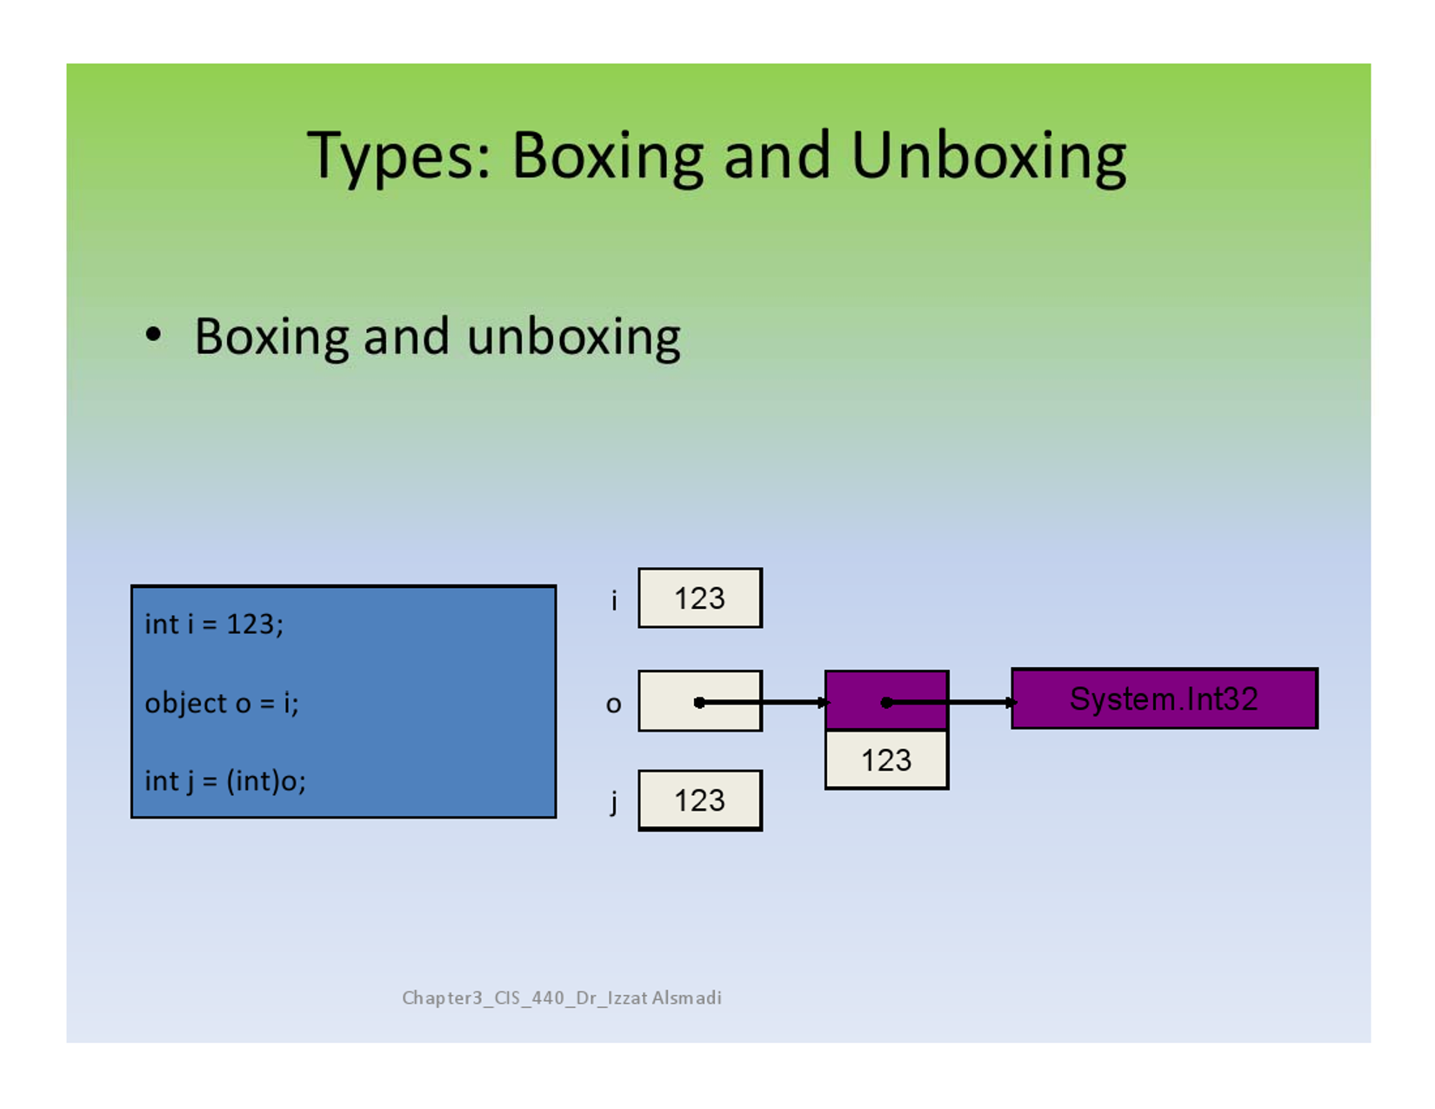
Types: Boxing and Unboxing
Boxing and Unboxing

Slide 16
Interfaces
An interface defines a contract
Includes methods, properties, indexers, events - Any class or struct implementing an interface
must support all parts of the contract
Interfaces provide polymorphism
Many classes and structs may implement a particular interface
Contain no implementation
Must be implemented by a class or struct

Slide 17
Interfaces
public interface IDelete {
void Delete();
}
public class TextBox : IDelete {
public void Delete() { ... }
}
public class Car : IDelete {
public void Delete() { ... }
}
TextBox tb = new TextBox( );
IDelete iDel = tb;
iDel.Delete( );
Car c = new Car( );
iDel = c;
iDel.Delete( );

Slide 18
Interface
No data members
No constructors, destructors
Not allow static member
Class members have no implementation
Many classes can implement the same interface
When a class implements an interface, the class must implement the entire interface.

Slide 19
Abstract Classes
An abstract class is one that cannot be instantiated
Intended to be used as a base class
May contain abstract and non-abstract function members
Similar to an interface
Cannot be sealed

Slide 20
Sealed Classes
A sealed class is one that cannot be used as a base class
Sealed classes can't be abstract
Why seal a class?
To prevent unintended derivation
Code optimization

Slide 21
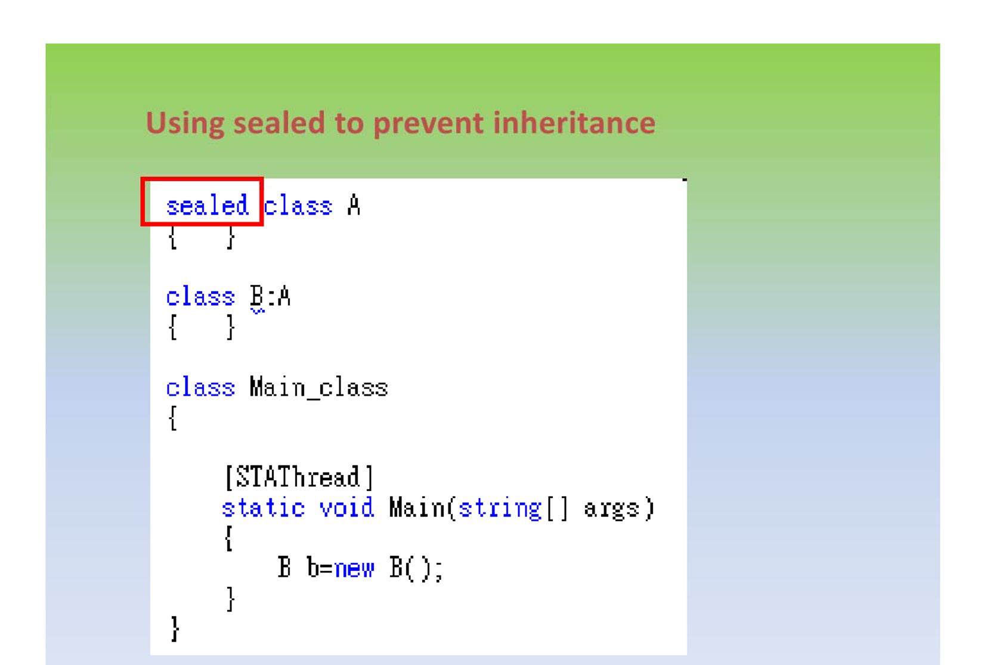
Using sealed to prevent inheritance

Slide 22
Single and Multiple Inheritance
Multiple inheritance allows a new class to inherit from two or more classes
Disadvantages of multiple inheritance:
Language and implementation complexity (in part due to name collisions)
Advantage:
Sometimes it is extremely convenient and valuable

Slide 23
Multiple Inheritance
Z
Display()
A
B
Display()
C
Which display() should C inherit?

